Slide 1
Click to start

Slide 2
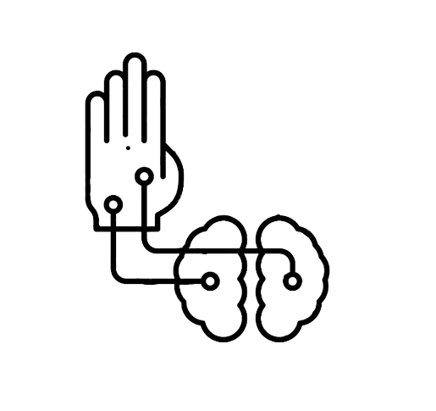
Prosthetic Arm using Brain Waves Recognition

Slide 3
AGENDA
Our project aims to create a AI model which can convert brain waves signal (receiving from headset) to hand movements which can further use in prosthetic arm, surgical robot arm, exoskeleton, etc.

Slide 4
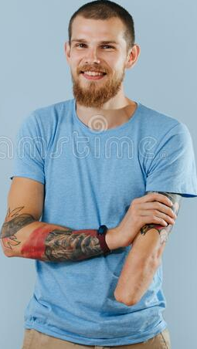

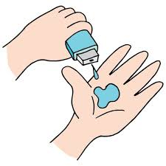
PROBLEM STATEMENT
Specially Abled People face many issues in their day to day life, even with prosthetic arm/leg based on nerve recognition fails at higher sensitivity. Here, we propose one time solution to directly take input from brain and connecting prosthetic arm/leg through brain wave recognition.

Slide 5
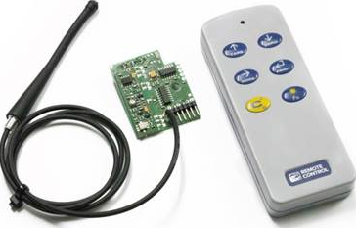
PROBLEM STATEMENT
Specially Abled People face many issues in their day to day life, even with prosthetic arm/leg based on nerve recognition fails at higher sensitivity. Here, we propose one time solution to directly take input from brain and connecting prosthetic arm/leg through brain wave recognition.

Slide 6

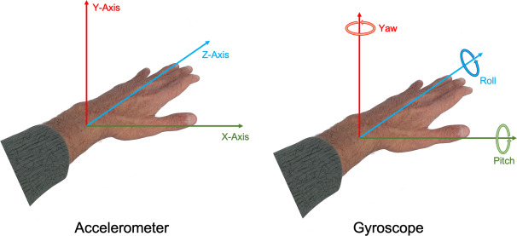
PROJECT OVERVIEW
Idea is to create a AI model which can convert EEG signals(Brain waves signals) into accelerometer and gyroscope readings in real time for robot to compute and use it in corresponding movements using hardware like prosthetic arm or surgical robotic arm.
To serve disabled people through economical and accurate algorithm that requires almost zero maintenance thanks to reinforcement learning.
To totally replace nerve recognition as it provides low resolution.

Slide 7

WHO ARE THE END USERS?
Our end users are disabled people like war veterans or people who have lost a limb in any accident, and then surgeons or specialists who have trained their minds to perform operations but are now unable to do so because of their age. Hence, this opens up new opportunities for such people.

Slide 8
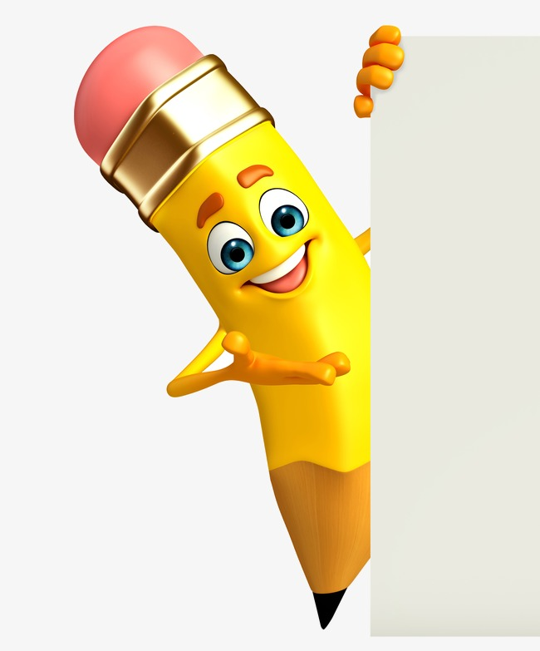
YOUR SOLUTION AND ITS VALUE PROPOSITION
Artificial Reflex
Using the IEEE Dataset(consist 256x200,000 raw data) we have trained the AI, which will follow protocol on each iteration, first it will preprocess EEG waves as it contains noises and interrupting emotions along with commands, secondly it will analysis it and it will generate gyroscope and accelerometer signals for arm using trained module.
In case same type of input signals received continuously (which means previous output is wrong) it will reanalyse it, generates proper output and re-learn from it through reinforcement reward and penalty system
51 MILLION Iteration

Slide 9
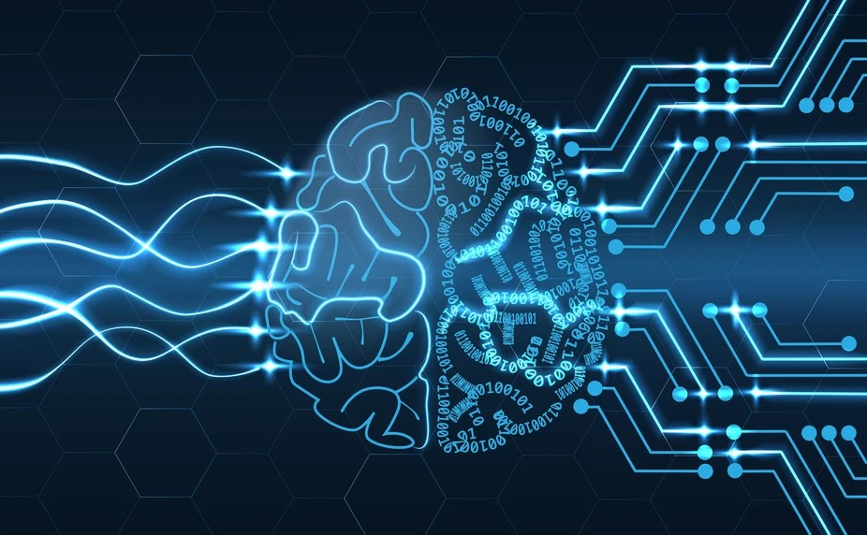
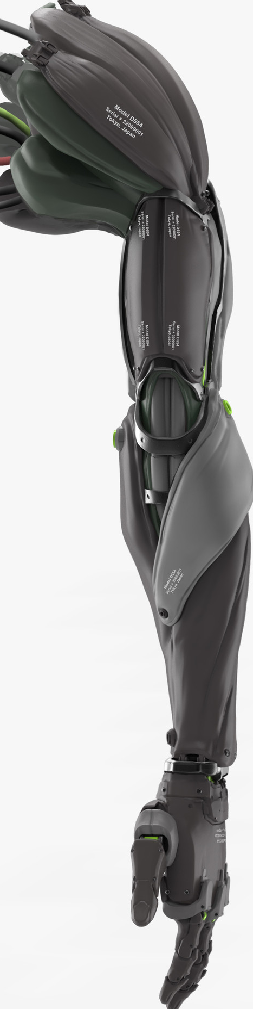
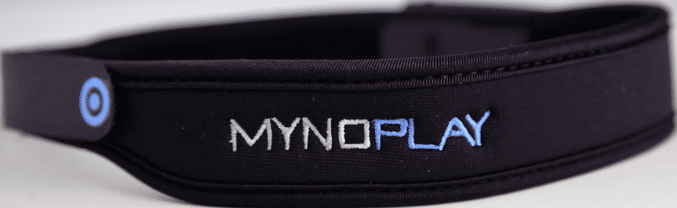

THE WOW IN YOUR SOLUTION
An IEEE BS-HMS-Dataset on Brain Signals and corresponding hand Movement Signals containing more than 200,000 rows of readings from a gyroscope and an accelerometer will be used. This data is taken from 32 volunteered participants who are subjected to different activities like reacting to happy emotion videos. This amount and type of data allows us to thoroughly train our A.I. model to adapt not only to different users but also the tasks it would be used for.

Slide 10
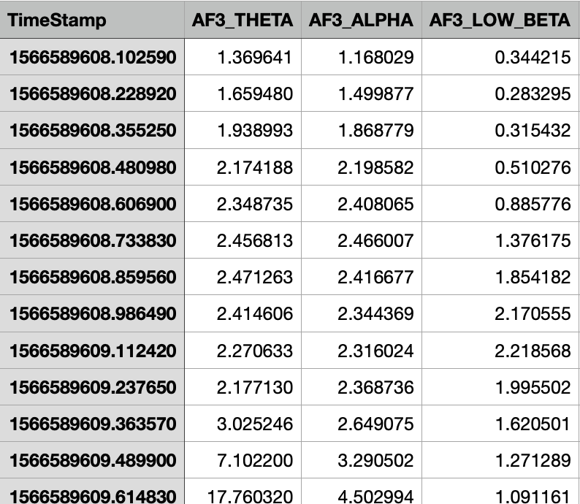
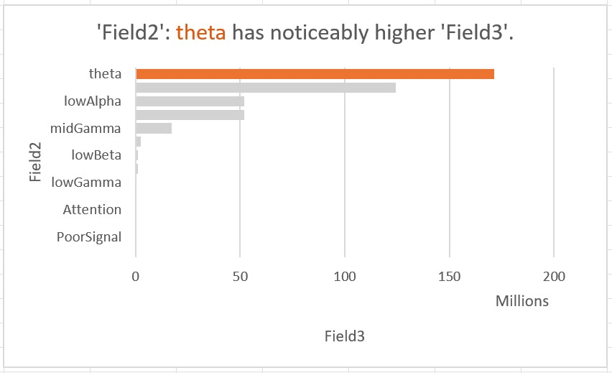
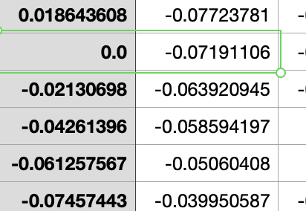
MODELLING
Capturing Raw EEG signals
Preprocessing(sorting, removing null values)
Analyzing

Slide 11
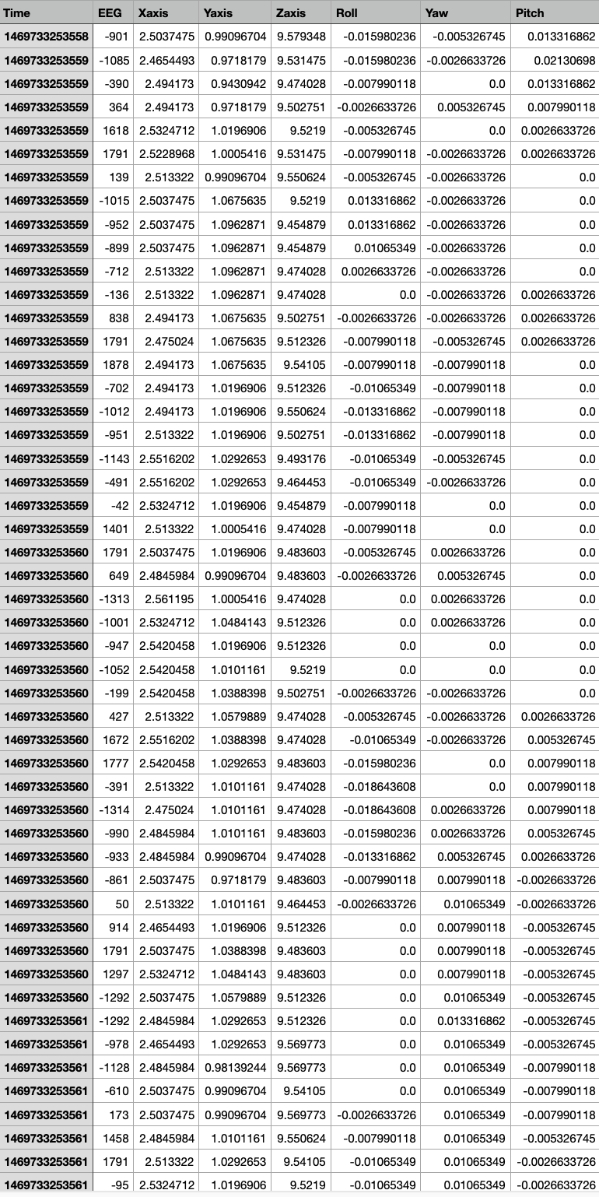

Slide 12
Removing Duplicate Values

Slide 16
128 NODES
64 NODES

Slide 17
X-axis
Y-axis
Z-axis
128 NODES
64 NODES
Roll
Yaw
Pitch

Slide 18
X-axis
Y-axis
Z-axis
128 NODES
64 NODES
Roll
Yaw
Pitch

Slide 19
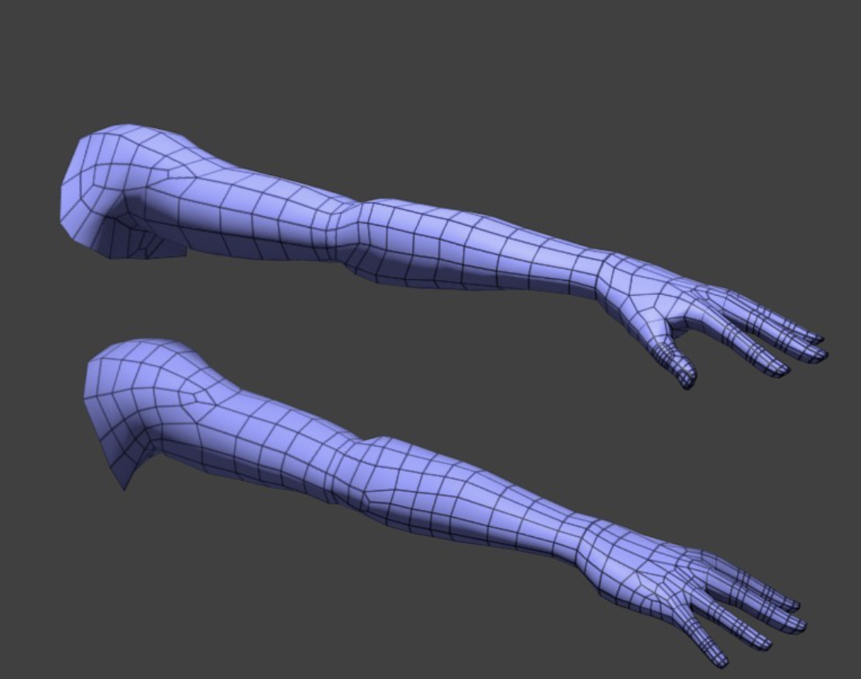
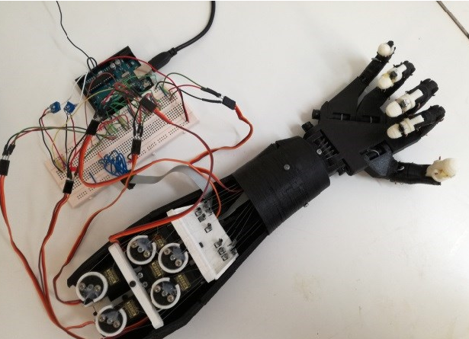
RESULTS
Software Representation
Hardware Presentation
3d simulation using Blender
HAND MOVEMENTS

Slide 20
APPLICATION
Prosthetics have proven to be the best alternative for people with amputated limbs, war veterans, or born-disable. 1 in 2 disabled people can afford treatment. Even though there are prosthetic arms ranging from 5000-9000 USD they have proved to be able to carry out minimum tasks like holding a cup. Our solution is to increase precision in all the activities they perform. Not just disabled people but, surgeons or specialists who are now unable to perform operations/procedures would have a second chance to get back into their line of work and help the people in need.

Slide 21
Scope For Improvement
Right now our project is not implemented using actual headset and hardware instead of that we are using real time 3d simulation to run algorithm.In future, we will implement on hardware with real disability case.
As we have mentioned several times about surgical robotic arms which is needed because after certain age skills and talent of senior surgeons gets extinguishes due to natural hand shivering.We want to improve that using this AI by relearning through real time gesture replicating surgery robots.
Higher sensitivity algorithm is needed, in some cases it requires higher resolution for the job, taking easy example like passing thread through needle using prosthetic arm or cutting deep and small cut in body cavity while performing surgery.
12

Slide 22

UNDER VOIS INTERNSHIP PROGRAM
Team 520
KASHYAP MISTRY
A.P.S. BENIPAL
KHUSH ATTARDE

Slide 23
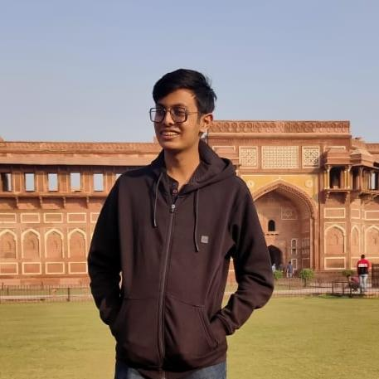
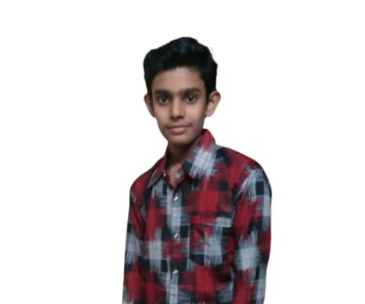
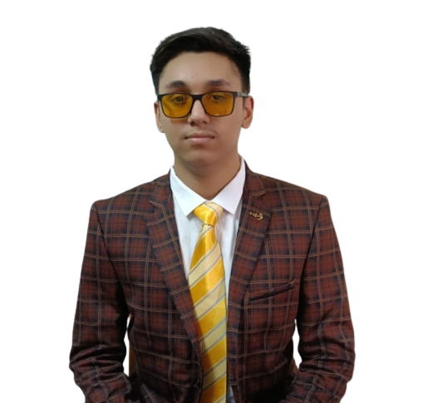
MEET OUR TEAM
Kashyap Mistry
Khush Attarde
.
A.P.S. Benipal

Slide 24

CREDITS
Stakeholders | Subject Matter Experts(SMEs) | Coaches

